Slide 1
Assignment 2: Results in a nutshell
By: Anthony Guevara

Slide 2
Overview
Scenario Overviews
Expected Results
Limitations

Slide 3
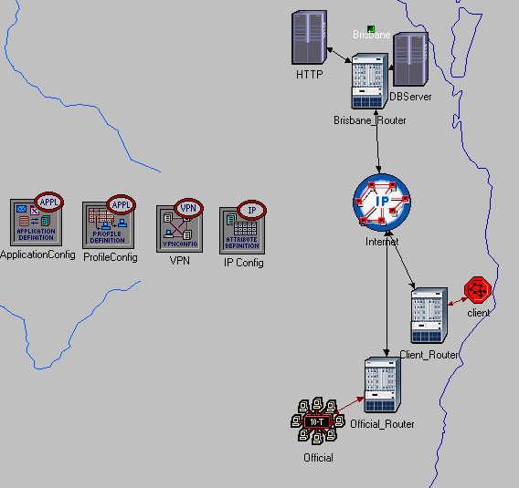
VPN Scenario

Slide 4
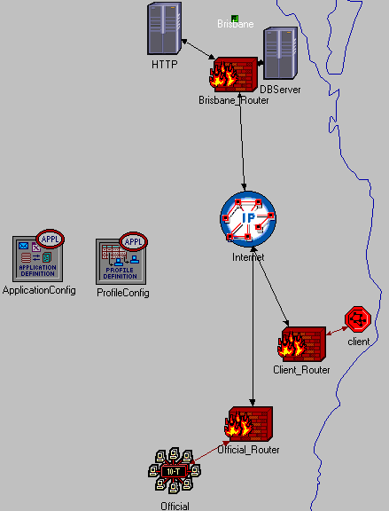
Firewall Only

Slide 5
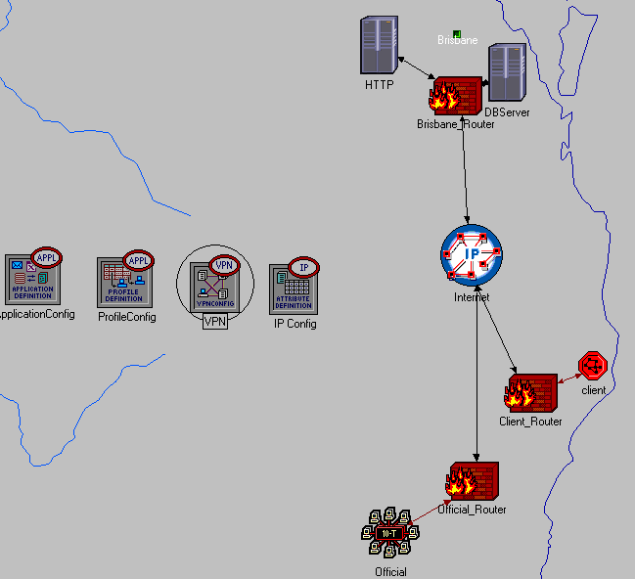
Firewall and VPN Scenario

Slide 6
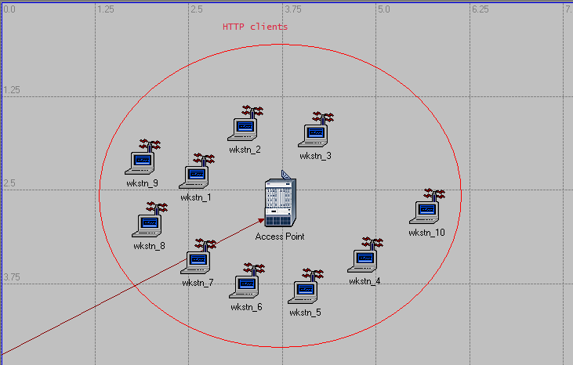
Wireless clients

Slide 7
Data Results
Database Query Traffic Sent and Received
Database Query Response Time
HTTP Traffic Sent and Received
HTTP Response Time

Slide 8
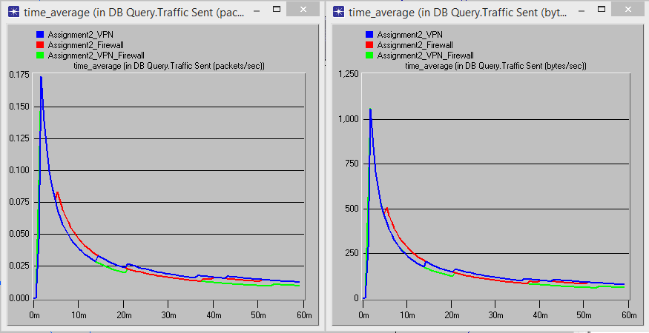
DB – Traffic Sent

Slide 9
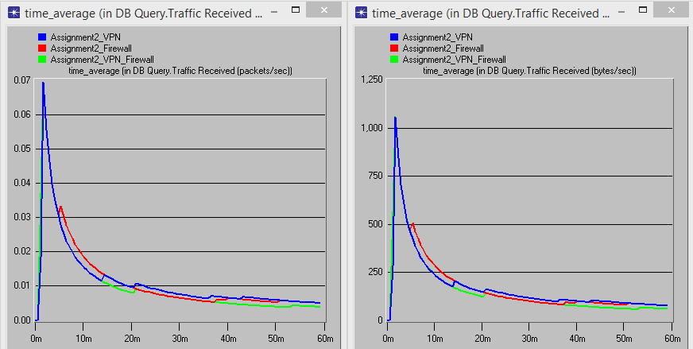
DB – Traffic Received

Slide 10
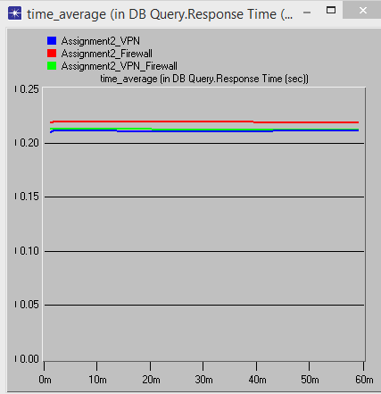
DB – Query Response Time

Slide 11
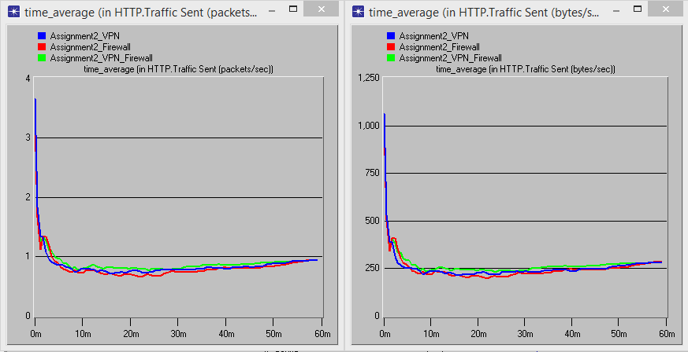
HTTP – Packets Sent

Slide 12
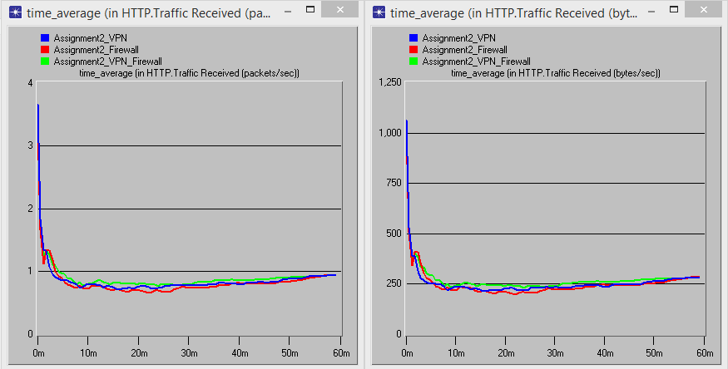
HTTP – Packets Received

Slide 13
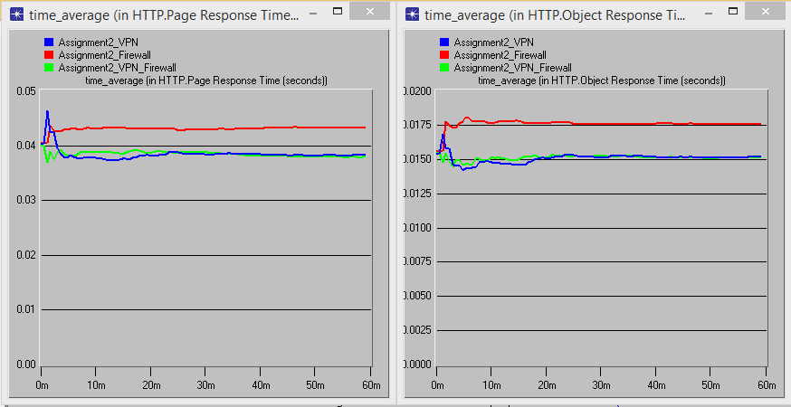
HTTP – Response Time

Slide 14
Limitations
Simulation vs real world
Best case scenario
Notes:
Encryption
Best case scenario for VPN because there was no background traffic

Slide 15
Recommendations
Client segment implements a firewall
Official segment implements VPN
Notes:
Firewall on the client segment to block certain types of traffic such as http video
Official segment is unlikely to scale once the infastructure is set up, VPN provides both encryption and compression

Slide 16
Conclusion
Notes:
-Based on results alone, I would recommend a VPN firewall implementation because it provided the quickest results for both HTTP and DB traffic
-Based on real world situation with cost limitations and background traffic

Slide 17

Questions

